Slide 1
Restaurant Management System
By Yi Yang, Kun Chen, Rui Da

Slide 2
Product Introduction
This product will be a generically designed restaurant management system. It can be imported to any kind of restaurant, providing functionality such as making reservation, checking in, making an order and checking out.

Slide 3
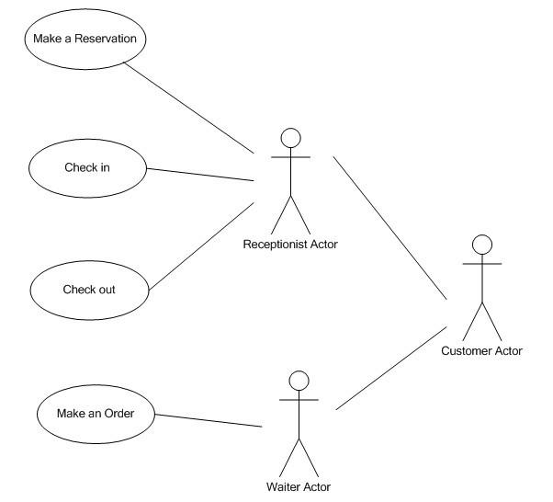
Use Case Diagram

Slide 4
Use Case: Make a Reservation
Actor: Receptionist
Goals: Help customer make a reservation for a specific date and time.
Precondition:
Summary: Receptionist finds available table for the specific date and time, record contact information, reserves the table for customer.
Related use case: None

Slide 5
Steps:
Actor actions System responses
1. Select “Reservation” command 2. Pop up reservation window
3. Select date and time, then search 4. Display all available tables the system
5. Select table size, type into 6. Pop up message indicates customer’s name and cell phone, making reservation successfully
submit reservation
7. Return to main window
Postconditions: table reserved for customer, record inserted into database, available table number decreases

Slide 6
Scenarios
Make a reservation
Steps:
Actor actions System responses
Select “Reservation” command Pop up reservation window
Set October 20 for date and Display all available tables
dinner for time, then search the
system
Type customer name “David”, Pop up message indicates making
cell phone “336-334-1234”, reservation successfully
reserve the table
Return to main window

Slide 7
Make a reservation
Steps:
Actor actions System responses
Select “Reservation” command Pop up reservation window
Set October 20 for date and No table is available
dinner for time, then search the
system
Exit reservation window, return
to main window

Slide 8
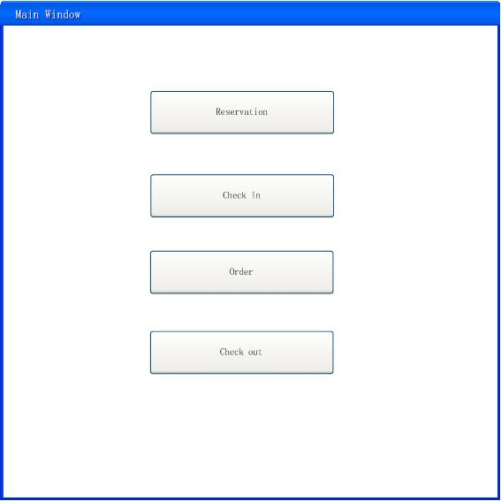
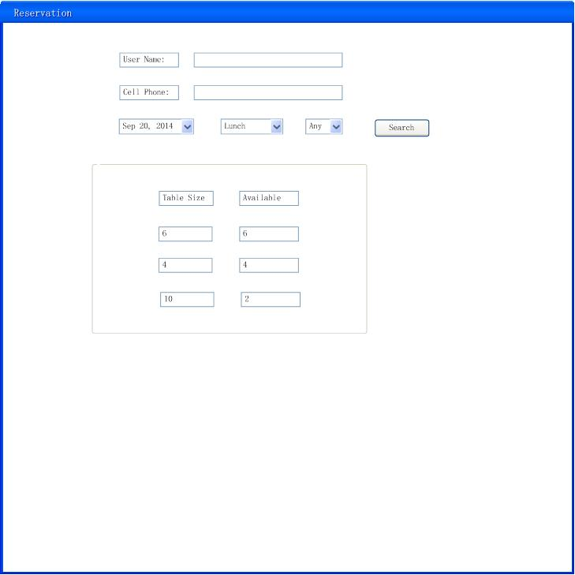
Interface

